Slide 1
Secure It Pro
SubmitTed By:
Marmik Patel (110280107003) Gaurav Shah(110280107020)
Niket Patel (110280107017) Nisarg shah (110280107050)

Slide 2
Team Details
Team id & Members
Guide by
ID:-7478
Team Members:-
Marmik Patel (110280107003)
Niket Patel (110280107017)
Gaurav Shah (110280107020)
Nisarg Shah (110280107050)
Guide By:-Bhavesh Oza

Slide 3
Points to Be Discussed
Basic Objectives
Schedule Of Project
Tools And Technology
Feasibility Study
Requirement Analysis
UML Diagrams
Data Dictionary
Design & Coding
Test Case
Future Plan & Conclusion

Slide 4
Basic Objective
In the world of smartphones, there are many android apps for security of data, mobile and apps, but main disadvantage of these apps are that they are needed to install separately. They are not available in single app and individual apps consumes more RAM.
Imagine, if all these features are available in a single application then the user need not to install all the applications separately. Our project is about develop such application.

Slide 5
Schedule Of Project
TITILE | STARTING DATE | ENDING DATE
PLANNING | 15TH JULY 2014 | 30TH JULY 2014
ANALYSIS | 1ST AUGUST 2014 | 30TH AUGUST 2014
DESIGN | 21ST SEPTEMBER 2014 | 10TH NOVEMBER 2014
CODING | 1ST JANUARY 2015 | 25TH FEBRUARY 2015
TESTING | 1ST MARCH 2015 | 15TH MARCH 2015

Slide 6
Tools and Technology
Eclipse Kepler IDE
Android AVD Manager
Android SDK Manager
Android Studio
Android Mobile
Android 4.0 and up

Slide 7
Feasibility Study
Existing System
In a existing system, android mobile users have to install individual application for securing of personal data, images; for preventing other user from accessing application; for facility of anti-theft. Some of examples of such applications are:
Applock
Hide it
Anti-theft

Slide 8
Feasibility Study
Disadvantages Of Existing System
All applications need to be install separately
Consumes more RAM
Consumes more Memory
Consumes more Battery as all applications are running background

Slide 9
Feasibility Study
Proposed System
Our project proposes a system in which all the facilities for security of android mobile and data in a single package. Our application have four module:
One Touch Calling
Anti-theft
application Lock
Data Hiding

Slide 10
Feasibility Study
One Touch Calling
One Touch Calling feature is useful in emergency situation. Using this application, user can call to predefined contact by Single touch.
Anti Theft
Anti-Theft feature is for securing mobile from thieves. This module send message to predefined contact on inserting a SIM card with different number which does not match with provided number while installation of application.

Slide 11
Feasibility Study
Application Lock
App Lock feature provides facility for locking of specific applications. To open application locked by App Lock , user have insert a password.
Data Hiding
This module hide personal data. To show this data user have to insert password.This features is able to provide password security upto 100x100x100 level. Data like images ,music files,video files etc.

Slide 12
Feasibility Study
Advantages Of Proposed System
All applications comes in single package
Consumes less RAM
Consumes less Memory
Consumes less Battery
Better user interface
Also provides features of one touch calling
Provides integrity

Slide 13
Requirement Analysis
Functional Requirements for Users
Set a password for Data Hiding
Set a password for accessing applications
Set a mobile number for Emergency Calling
Set a mobile number for Anti-theft
Set a dummy password for Data Hiding

Slide 14
Requirement Analysis
Non functional Requirements
Efficiency
Integrity
Availabity
Security
Maintenance

Slide 15
System Requirements
Minimum Requirements( Mobile)
Capable of running Android 4.0 or later
512 MB RAM
800 MHz processor
512 MB of internal memory for installation of application

Slide 16
System Requirements
Recommended Requirements( Mobile)
Capable of running Android 4.0 or later
1 GB RAM
1 GHz dual/quad core processor
1 GB of internal memory for installation of application
Desktop/Laptop for development
Windows or Linux or Mac Operating System
Java Runtime Environment
Android Development Toolkit

Slide 17
UML Diagrams(Use Case)

Slide 22
UML Diagrams (Sequence Diagram)

Slide 27
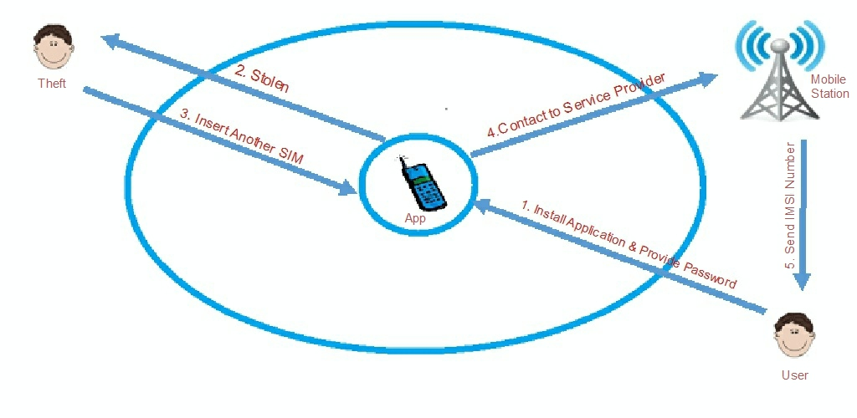
Flow Diagram (Anti-Theft)

Slide 28
Data Dictionary
AntiTheft_login
Field Name | Type | Size | Allow Null | Description
id | int | 15 | N | User ID
Email id | varchar | 150 | N | Email ID of user
password | varchar | 20 | N | Password of user
active | boolean |  | Y | Status of user

Slide 29
Data Dictionary
AntiTheft_profile_detail
Field Name | Type | Size | Allow Null | Description
id | int | 15 | N | User ID
name | varchar | 150 | N | User Name
emailid | varchar | 150 | N | Email ID of user
mobile_number | varchar | 15 | N | Mobile Number of user
sim_number | varchar | 45 | N | Sim Number of card.
IMEI | varchar | 15 | N | IMEI number of user mobile.

Slide 30
Data Dictionary
AntiTheft_seq_que
Field Name | Type | Size | Allow Null | Description
id | int | 15 | N | User ID
question | varchar | 45 | N | Security question
answer | varchar | 45 | N | Security answer

Slide 31
Data Dictionary
AntiTheft_location
Field Name | Type | Size | Allow Null | Description
id | int | 15 | N | User ID
longitude | varchar | 45 | N | Logitude of location
latitude | varchar | 45 | N | Latitude of location
time | timestamp |  | N | Time when mobile is traced.

Slide 32
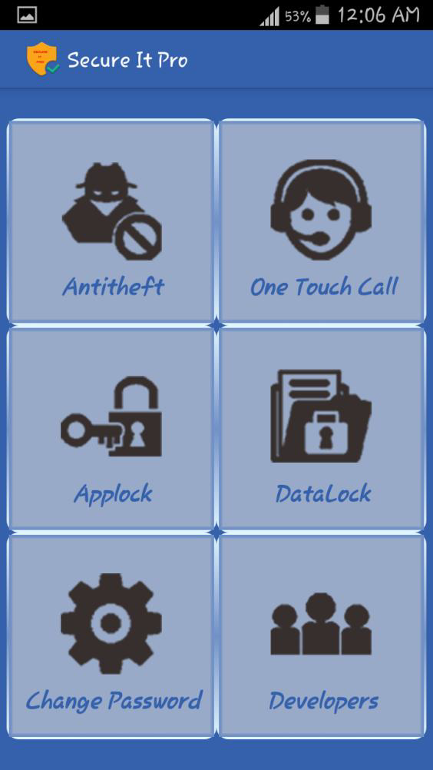
Design(Main Screen)
When Secure It Pro app starts this is a very first page that opens.
It contains link to the four module along with setting facility.
On clicking the Antitheft Icon Antitheft module will run. And same
For other three modules.

Slide 33
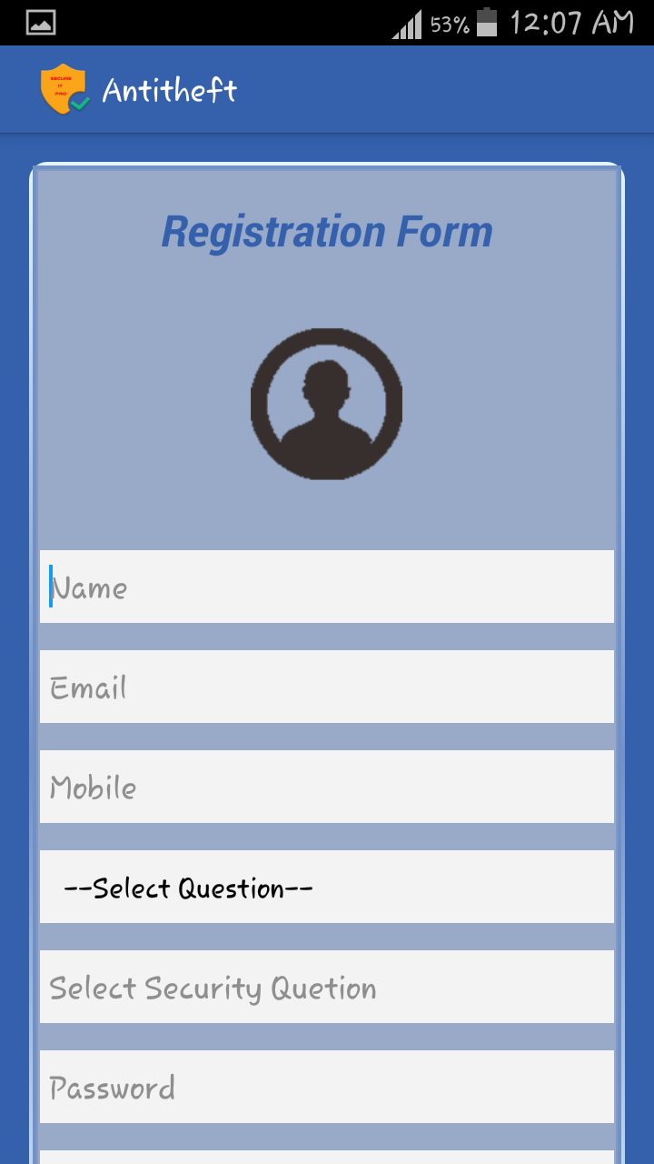
Design(Anti Theft)
First time when user opens Anti theft , Registration form is displayed.
After inserting particular values , click on submit button to register
Yourself to antitheft.

Slide 34
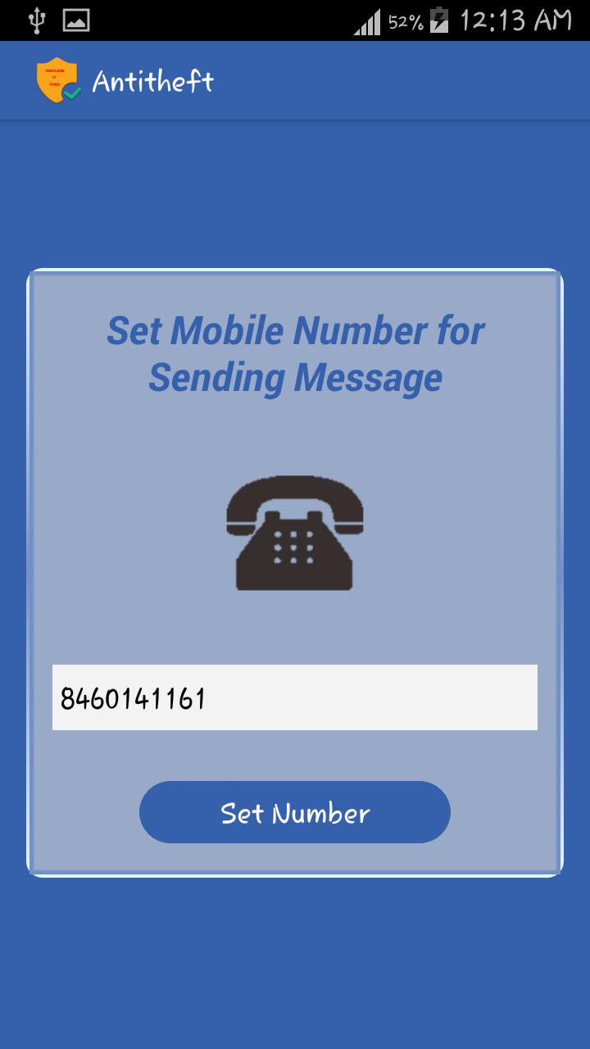
Design(Anti Theft)
On Clicking the “Set Mobile Number” Button we will move to
This Screen.
Here we can set Mobile Number on which we want to send a
Message showing current location of our mobile device.

Slide 35
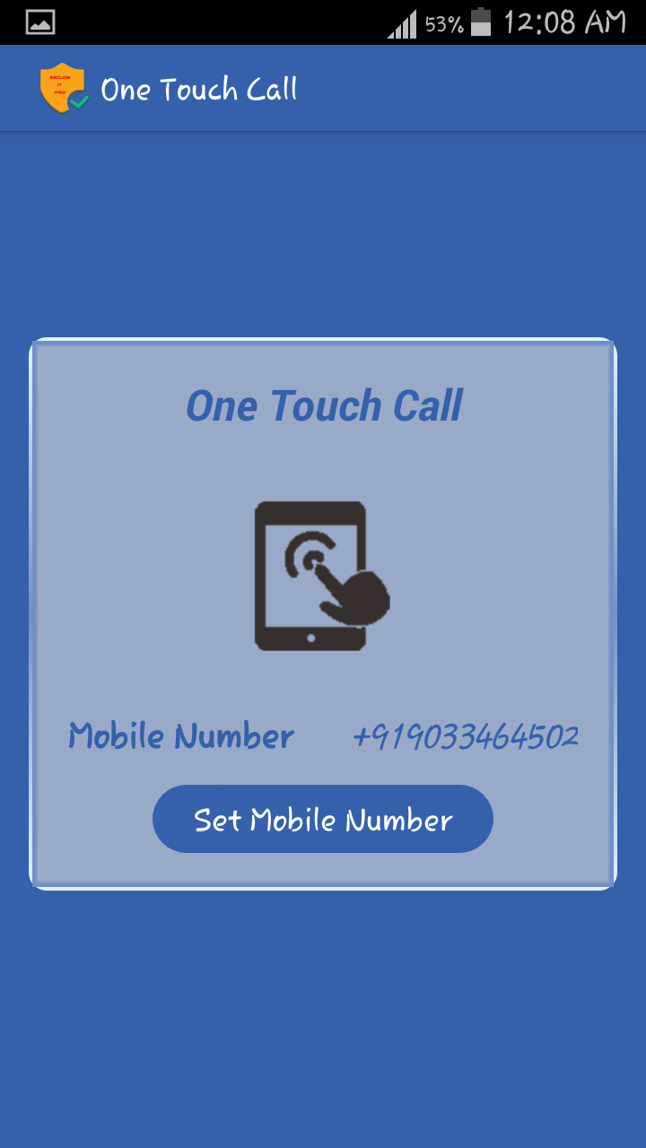
Design(One Touch Call)
On Clicking the One Touch Call Icon we get this screen.
Initially Mobile Number is not specified.
We can set mobile number by clicking on “Set Mobile Number
Button” .

Slide 36
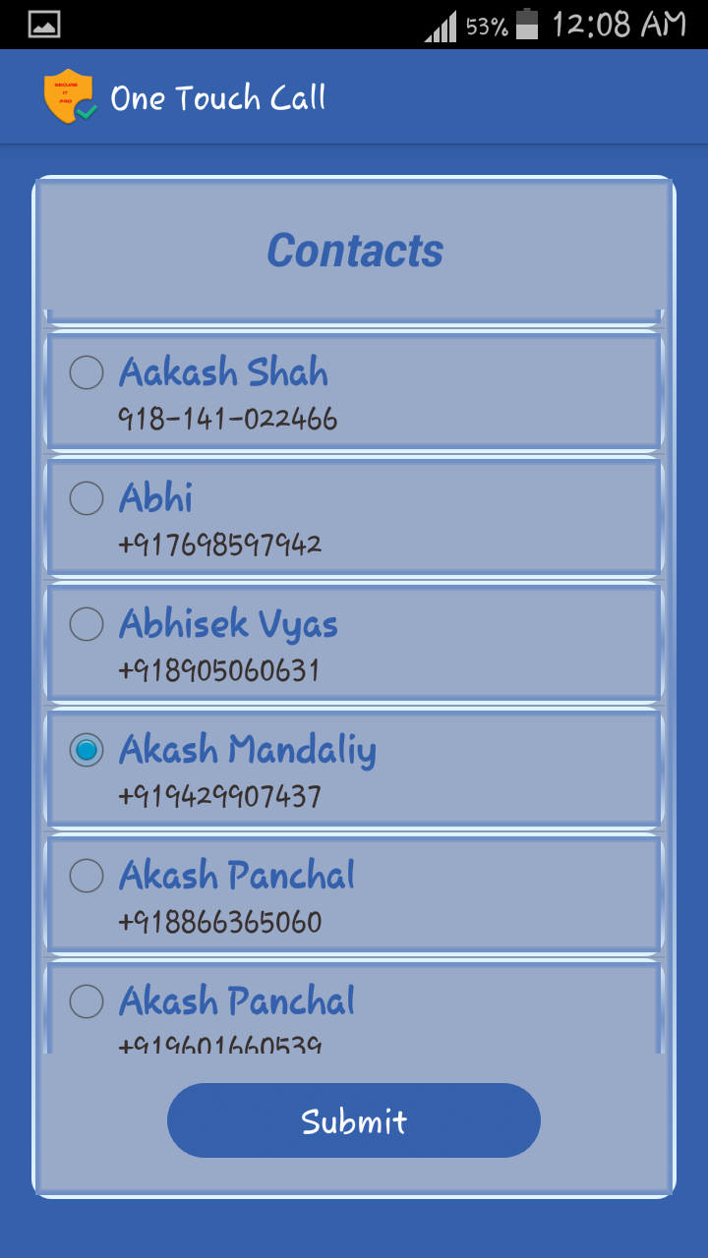
Design(One Touch Call)
Here the List of all contacts saved in your mobile will be displayed
along with a Radio Button.
By Selecting a Checkbox we will get the number on which we can
Transfer a call.

Slide 37
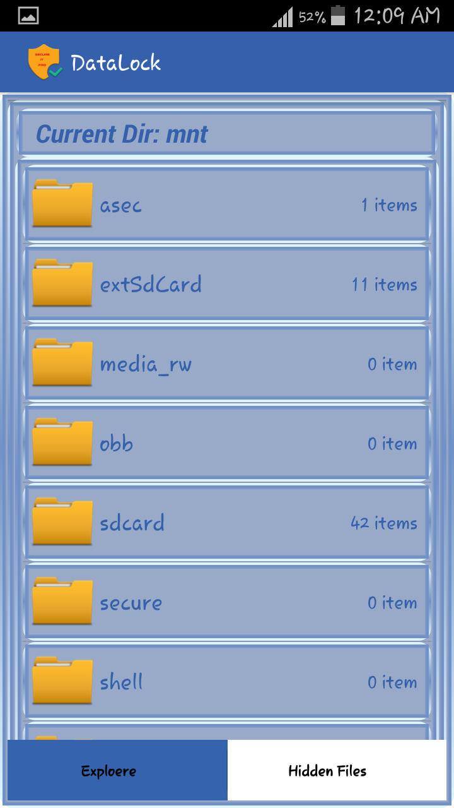
Design(Data Hiding)
After clicking Data hiding icon, File explorer is opened.
Just route the file and select that file that you want to hide.

Slide 38
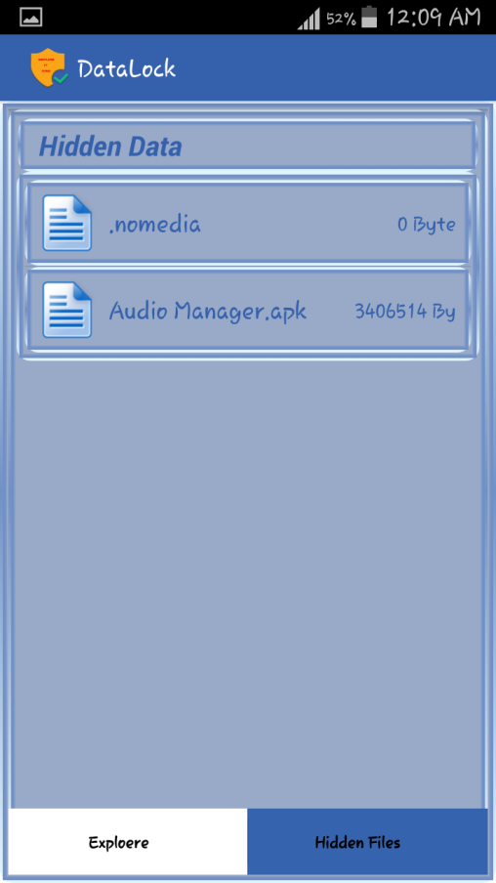
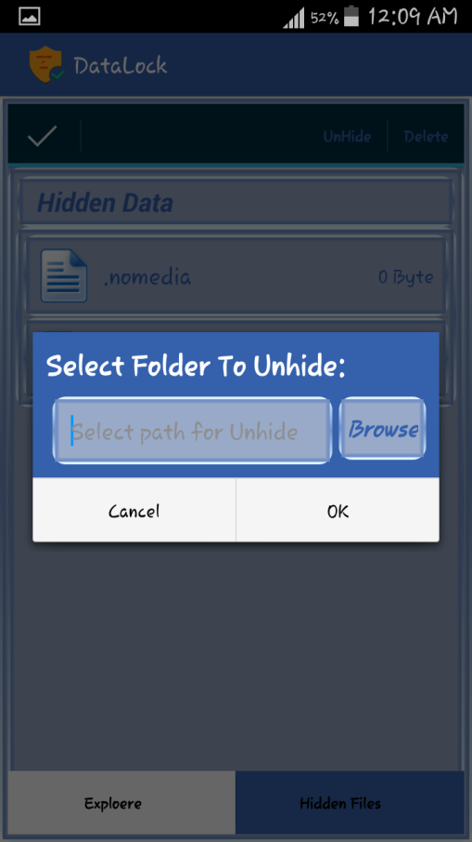
Design(Data Hiding)
By clicking hidden files we can see those files which are hidden.
Just long press any files and unhide it.

Slide 39
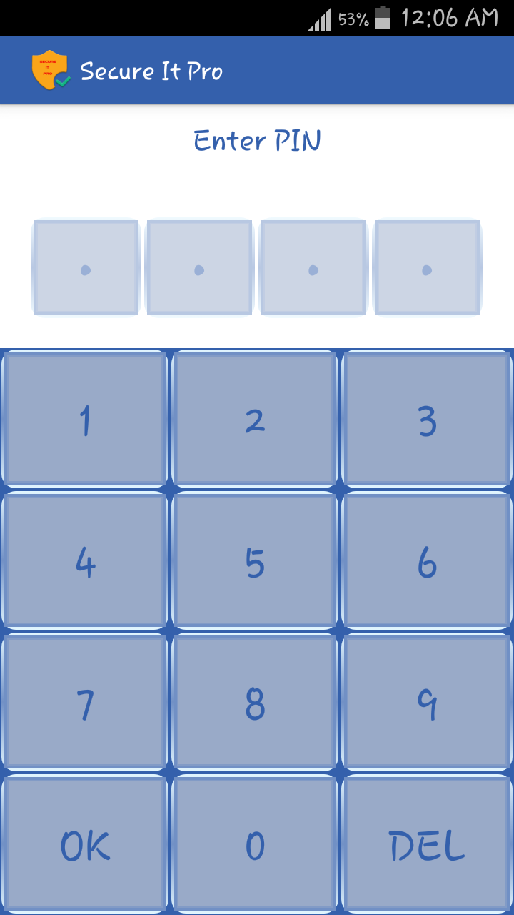
Design(App Lock)
This is a LockScreen which will display when the apps selected by user will be in foreground.
On Entering a Correct Password we need to click on OK Button. So we get access to that app.

Slide 40
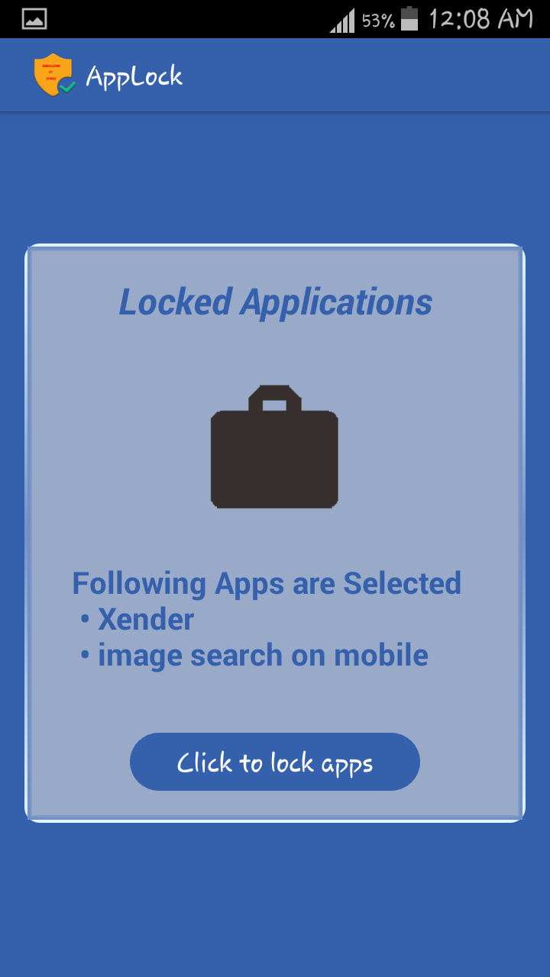
Design(App Lock)
Initially No Apps are selected.
Once we click “Click to lock apps” Button we can select the
apps that we want to protect using password.
And All that Apps Will be displayed on screen.

Slide 41
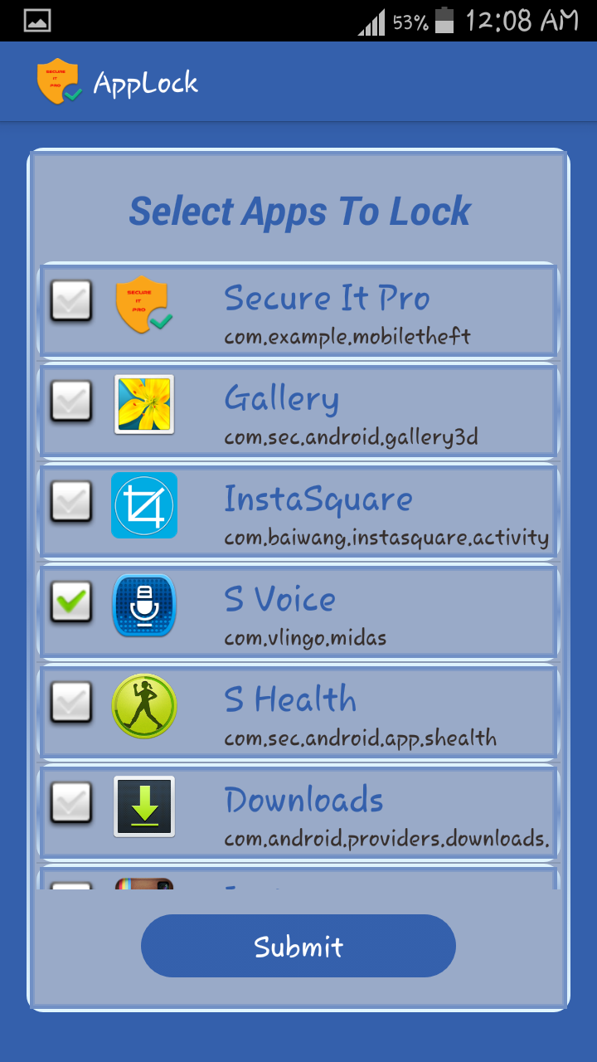
Design(App Lock)
Here List of all Apps along with Checkbox are displayed .
We can select more than one apps and click on submit button .
So all the selected apps will be protected with password.

Slide 42
Design(Login Page)
Here you have t enter username and password which is entered
at registration time.

Slide 43
Design(Location page)
Here you can see the google map which shows the current location of
mobile. You can live trace your mobile.

Slide 44
Design(Location page)
Here you can see your personal details like Name , Email Id ,IMEI etc.

Slide 45
Design(Change Password)
Here you can change your password by entering old password
and new password.

Slide 46
Coding(AndroidManifest.xml)
Set Permission:
<uses-permission android:name="android.permission.RECEIVE_BOOT_COMPLETED" />
Application Activity:
<application
android:allowBackup=“true”
android:icon=“@drawable/ic_laucher”
android:label=“@string/app_name”
android:theme=“@style/AppTheme”
<activity
android:name=“.RegistrationForm”
android:label=“@string/app_name”>
</activity>
<application>

Slide 47
Coding(AndroidManifest.xml)
Recevier:
<receiver android:name="receiver.StartUpdateLocationServiceIfNot"
android:enabled="true"
android:exported="true"
android:permission="android.permission.RECEIVE_BOOT_COMPLETED" >
<intent-filter>
<action android:name="android.intent.action.BOOT_COMPLETED" />
<action android:name="android.intent.action.QUICKBOOT_POWERON" />
<action android:name="android.intent.action.USER_PRESENT" />
<action android:name="android.intent.action.ACTION_SHUTDOWN" />
<category android:name="android.intent.category.HOME" />
<category android:name="android.intent.category.DEFAULT" />
</intent-filter>
</receiver>

Slide 48
Coding(mainmodule.xml)
TableLayout:
<TableLayout
android:layout_width="wrap_content"
android:layout_height="wrap_content"
android:layout_gravity="center_horizontal"
android:layout_weight="0.5"
android:gravity="center_horizontal" >
<TableRow
android:layout_width="wrap_content"
android:layout_height="wrap_content"
android:layout_gravity="center_horizontal"
android:gravity="center_horizontal" >
</TableRow>
</TableLayout>

Slide 49
Test Cases
Test Case for user login(valid)
Name | Description
Purpose | Login is used for tracing his mobile and also to view and update profile.
Prereq | For login user must be registered through mobile device.
Test Data | EmailID = {valid emailID} Password = {valid password}
Steps | Steps to carry out the test 1.Visit the login page 2.Enter emailID 3.Enter password 5.Enter Login Button 6.Verify message of successful login. 7.Visit Home page.
Notes and Question | Note :- Password must be atleast 4 characters.

Slide 50
Test Cases
Test Case for user login(invalid)
Name | Description
Purpose | Login is used for tracing his mobile and also to view and update profile.
Prereq | For login user must be registered through mobile device.
Test Data | EmailID = {invalid,emailID,empty} Password = {invalid,password,empty} or EmailID={valid,emailID} Password={invalid,empty} or EmailID= {empty} Password= {empty}
Steps | Steps to carry out the test 1.Visit the login page 2.Enter emailID 3.Enter password 5.Enter Login Button 6.Verify message of invalid emailID or password.. 7.Go back to login page.
Notes and Question | Note :- Password must be atleast 4 characters.

Slide 51
Test Cases
Test Case for user Registration
Name | Description
Purpose | User Registration is used for login and user profile.
Prereq | For user registration, user must need to fill all the details of registration form.
Test Data | Name ={valid name,invalidname,empty} Email={valid Email,invalidEmail,empty} Mobile={valid Mobile,invalidMobile,empty} Password={valid Password,invalidPassword,empty} Confirm password={valid confirm password,invalid confirm password,empty}
Steps | Steps to carry out the test 1.Visit the Registration Form page. 2.Enter the required details. 3.Click on Submit. 4.See Home Page. 5.Verify the message.
Notes and Question | Note :- Password must be atleast 4 characters.

Slide 52
Future Plan
The Ideal scope for any system should be that it should be everlasting. But we know that, in today’s world, anything cannot be everlasting as things change within seconds. So, out system cannot be everlasting, as one should always keep pace with the requirement.
In Future, we will provide encryption-decryption to protect our data. We will also provide remote phone locking system and offline mobile tracing system also.
We will provide pattern lock apart from password to lock mobile.

Slide 53
Conclusion
The scope of the project has been described and it will able to provide security to data, mobile, application etc.
This application offers best GUI to users and take care of android device resources as well.

Slide 54
Bibliography
http://developer.android.com/develop/index.html
http://developer.android.com/training/index.html
http://developer.android.com/guide/components/index.html
http://developer.android.com/google/index.html
http://stackoverflow.com/
http://www.technotalkative.com/android/
http://www.technotalkative.com/adt-bundle-a-single-step-to-setup-android-development-environment/
http://developer.android.com/reference/android/telephony/TelephonyManager.html

Slide 55


